Slide 1
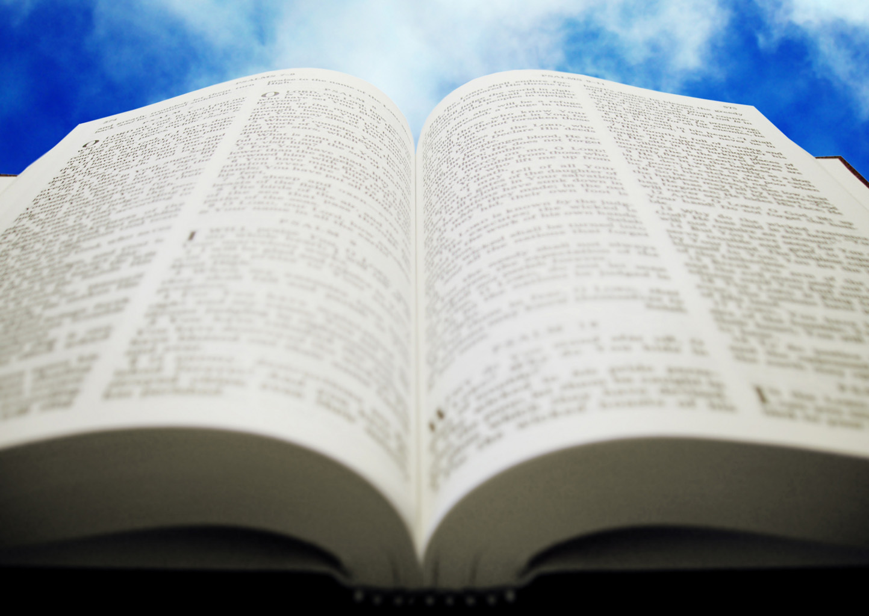
Welcome!
Sunday
Bible Study 9:30 AM
Worship 10:30 AM
Wednesday
Bible Class 7:00 PM
www.SunsetchurchofChrist.net

Slide 2
John 8:21-30
Jesus reveals His goal
Belief in Jesus
Speaking from the Father

Slide 3
Welcome!
Sunday
Bible Study 9:30 AM
Worship 10:30 AM
Wednesday
Bible Class 7:00 PM
www.SunsetchurchofChrist.net

Slide 4
Opening Prayer | Gregor Hinckley
Song – | Grant Haines
Scripture Reading | Lamar McDonald
Song – | Grant Haines
Song – | Grant Haines
Lord’s Supper | Lamar McDonald / Anthony Ward
Song – | Grant Haines
Collection | Lamar McDonald / Anthony Ward
Song – | Grant Haines
Lesson | Brian Haines
Song – | Grant Haines
Closing | Ryan Sollars

Slide 5
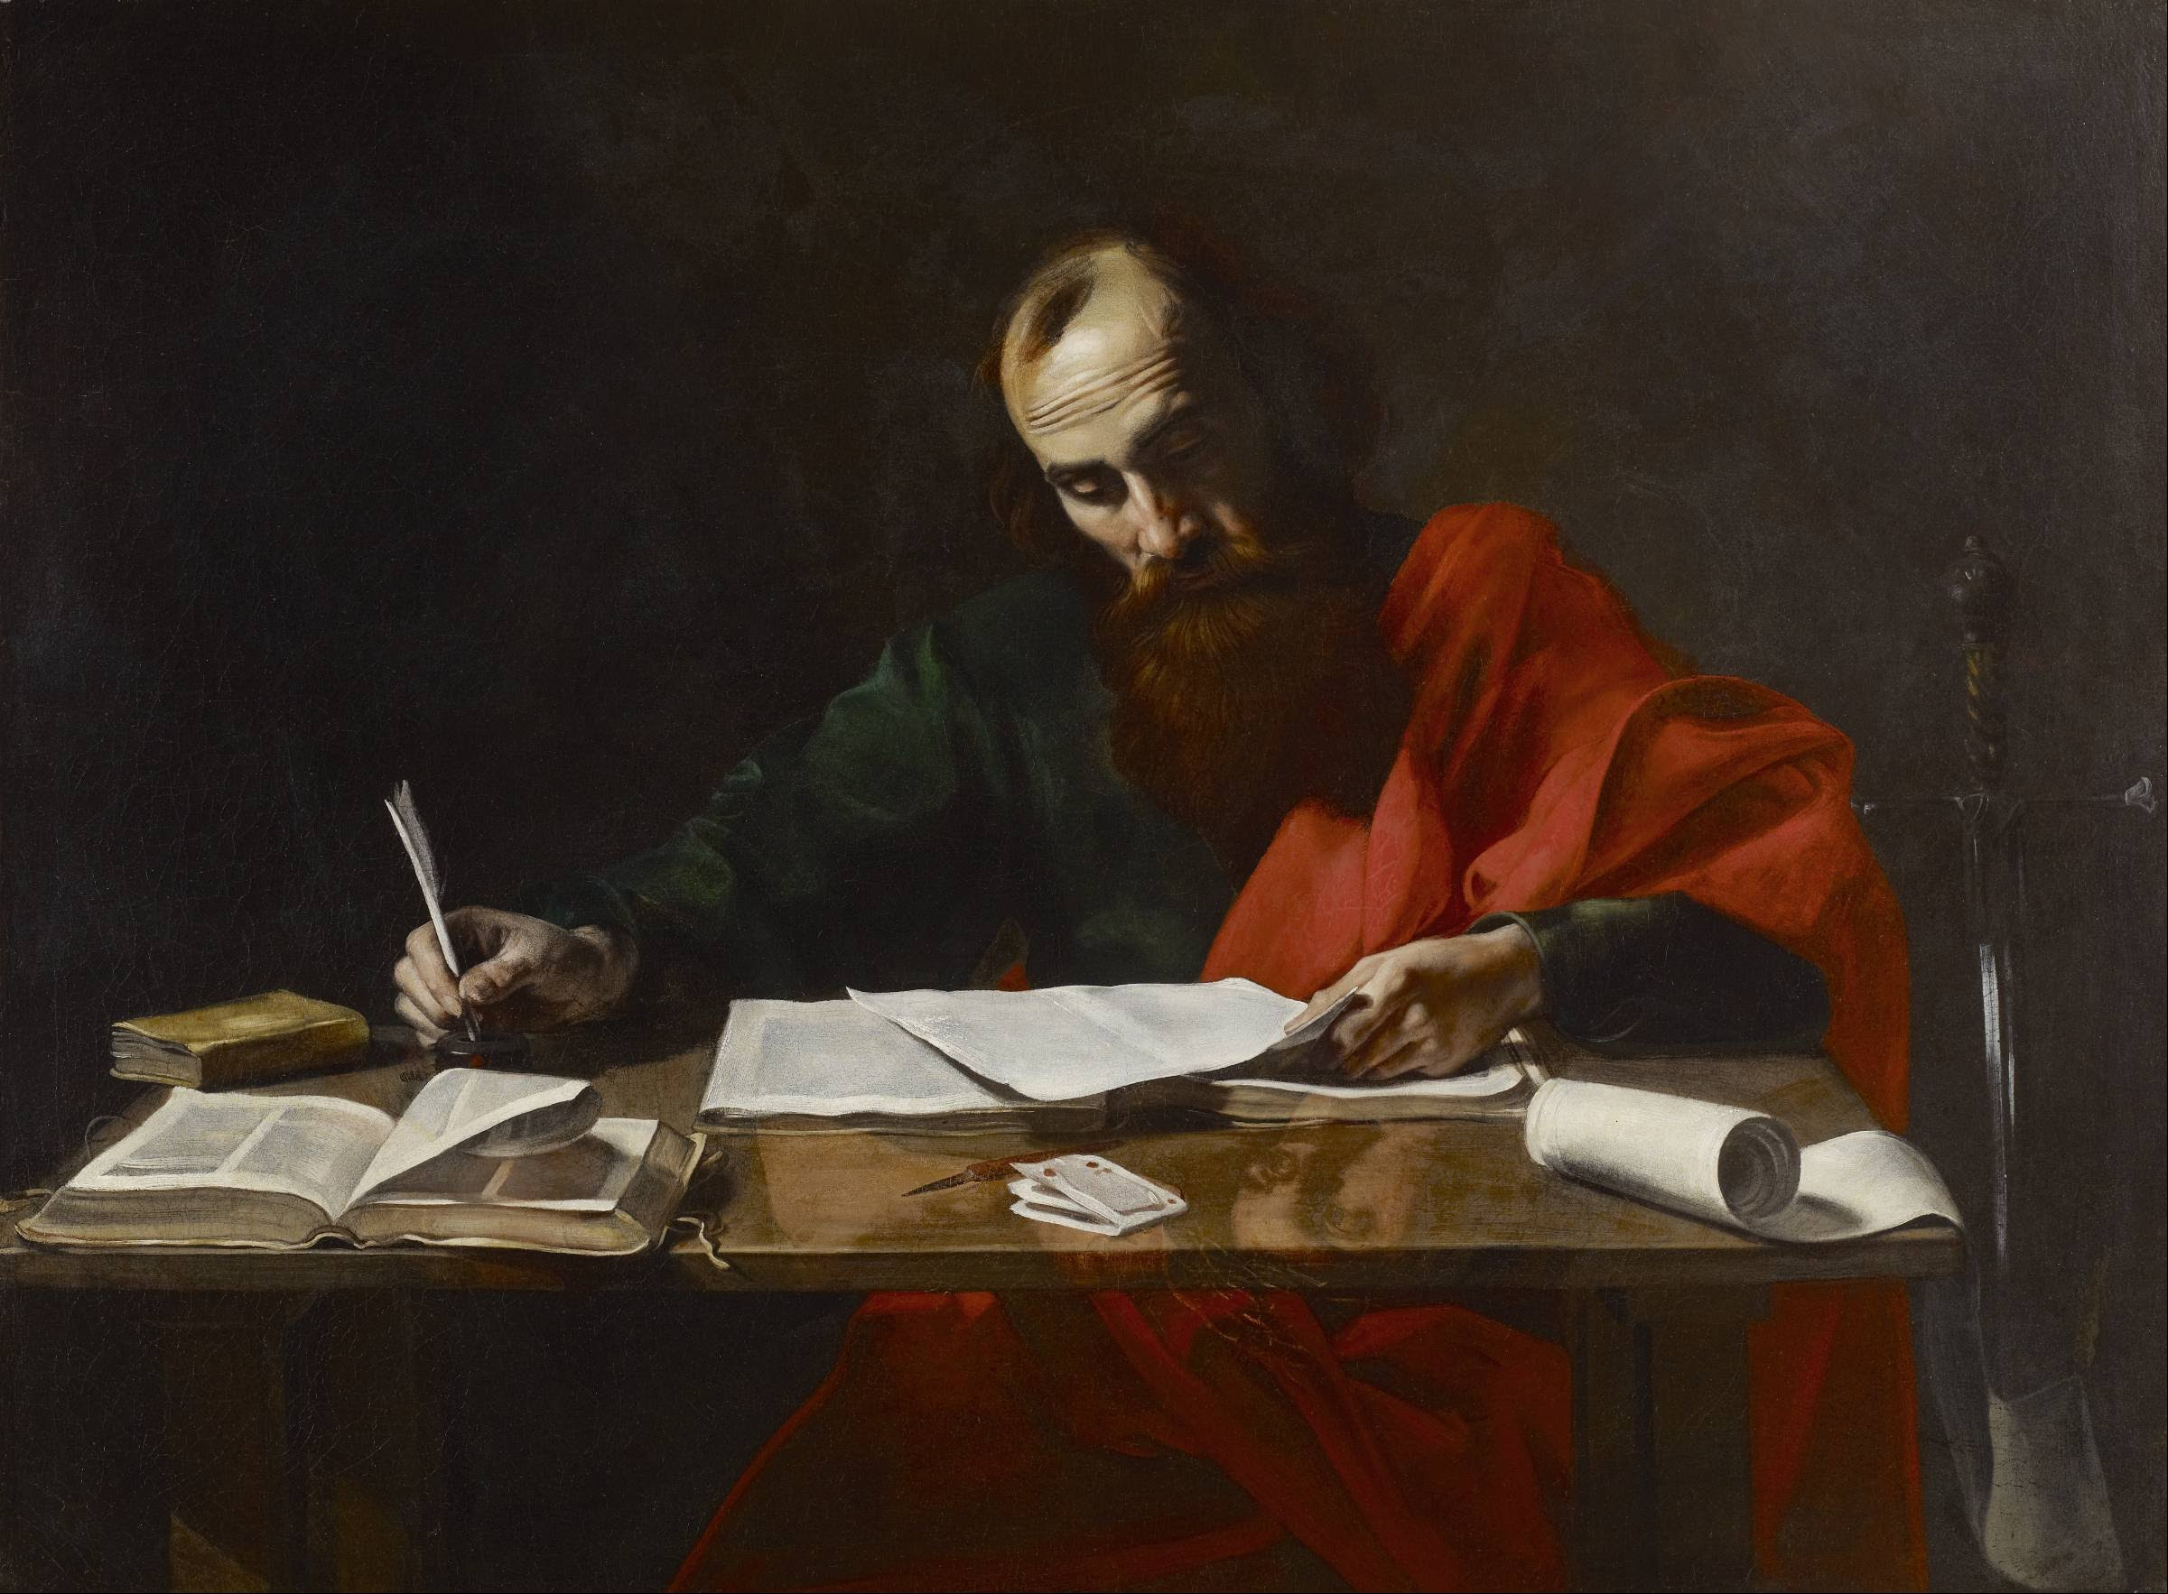
Paul’s Corinthian Advice
1 Corinthians 8
Learning To Use Liberty

Slide 6
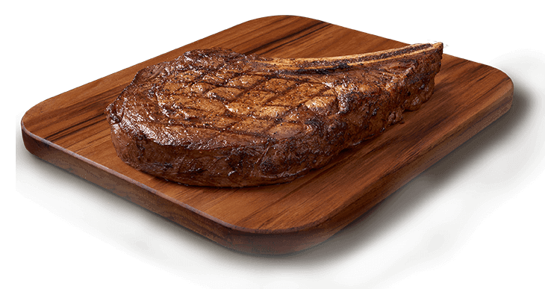
Paul’s Declaration
Therefore, if food makes my brother stumble, I will never again eat meat, lest I make my brother stumble. 1 Corinthians 8:13

Slide 7
Paul’s Declaration
Therefore, if food makes my brother stumble, I will never again eat meat, lest I make my brother stumble. 1 Corinthians 8:13

Slide 8
Context of 1 Corinthians 8
Eating meat sacrificed to idols
1. Idols are empty; there are no gods
2. Not all know this
3. To us it does not matter (liberty)
4. Use liberty to avoid offending others

Slide 9
Parallel to Romans 14
But food does not commend us to God; for neither if we eat are we the better, nor if we do not eat are we the worse. 1 Corinthians 8:8
For the kingdom of God is not eating and drinking, but righteousness and peace and joy in the Holy Spirit. Romans 14:17

Slide 10
Understanding Liberty
Liberty in America
The right to do what I want
Liberty in Christ
The right to give up what I want

Slide 11
Understanding Liberty
For you, brethren, have been called to liberty; only do not use liberty as an opportunity for the flesh, but through love serve one another. Galatians 5:13

Slide 12
Understanding Liberty
Liberty is NOT:
Freedom from the law of Christ
Agree to disagree on matters of faith
Submission of the congregation to one
Notes:
Jas 2:12 So speak and so do as those who will be judged by the law of liberty.

Slide 13
Matters of Truth
John 17:17
Matters of Judgment
1 Cor. 7:25
Phm. 14
Notes:
1Co 7:25 Now concerning virgins: I have no commandment from the Lord; yet I give judgment as one whom the Lord in His mercy has made trustworthy.
Phm 1:14 But without your consent I wanted to do nothing, that your good deed might not be by compulsion, as it were, but voluntary.

Slide 14
Applications
We now have liberty
- All foods are clean
Clean and unclean are passed
- Liberty to engage the world
Not to participate in it
To engage in appropriate manners
Notes:
Ro 14:14 I know and am convinced by the Lord Jesus that there is nothing unclean of itself; but to him who considers anything to be unclean, to him it is unclean.
Mr 7:19 because it does not go into his heart, but into his stomach, and is eliminated? "Thus He declared all foods clean.

Slide 15
Applications
We (must) all have knowledge
- Of what God expects
Faith vs. judgment (opinion)
- Of one another’s weaknesses
We are accountable to each other

Slide 16
Applications
We must do whatever we can:
- To help each other be faithful
- To avoid causing stumbling

Slide 17
Examples of Application
Celebrating holidays
Engaging with businesses
Entertainment
COVID behaviors

Slide 18
Fulfilling This Command
Therefore let us pursue the things which make for peace and the things by which one may edify another. Romans 14:19

Slide 20
“If you love Me….”
"If you love Me, keep My commandments” John 14:15
“If anyone loves Me, he will keep My word” John 14:23

Slide 21
Jesus Said:
"Most assuredly, I say to you, he who hears My word and believes in Him who sent Me has everlasting life” John 5:24

Slide 22
Jesus Said:
"Therefore whoever confesses Me before men, him I will also confess before My Father who is in heaven.” Matthew 10:32

Slide 23
Jesus Said:
From that time Jesus began to preach and to say, "Repent, for the kingdom of heaven is at hand." Matthew 4:17

Slide 24
Jesus Said:
And He said to them……."He who believes and is baptized will be saved; but he who does not believe will be condemned.” Mark 16:15,16

